Slide 1
Security and UX
Programming Usable Interfaces (PUI)
Software Structures for User Interfaces (SSUI)
Fall 2016
Jason Hong
jasonh@cs.cmu.edu
Notes:
Video to preload: https://www.youtube.com/watch?v=Abt8aAB-Dr0

Slide 2
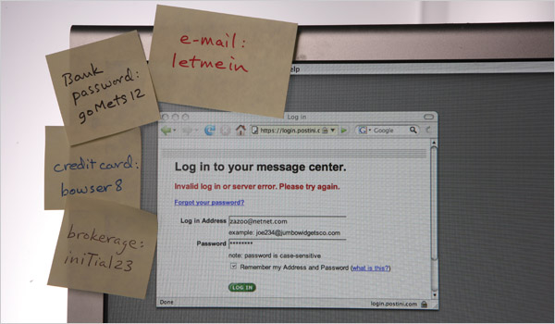
Unusable Privacy and Security
Malware
Fake anti-virus
Fake s/w updates
Fake video codecs
Fake account breaches
Passwords
Social networks
Oversharing
Accidental sharing
Fake friends

Slide 3
Security Breaches Due to UX
More and more security problems are due in part to human factors issues
And not systems, networking, or algorithms
RSA Security, LA Hospital → phishing (+ ransomware)
DoD malware, StuxNet → USB keys
Veterans Affairs → stolen laptop
Mirai botnet → default passwords
Google blacklists all → misconfiguration

Slide 4
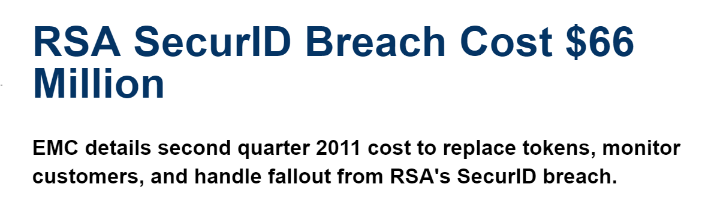
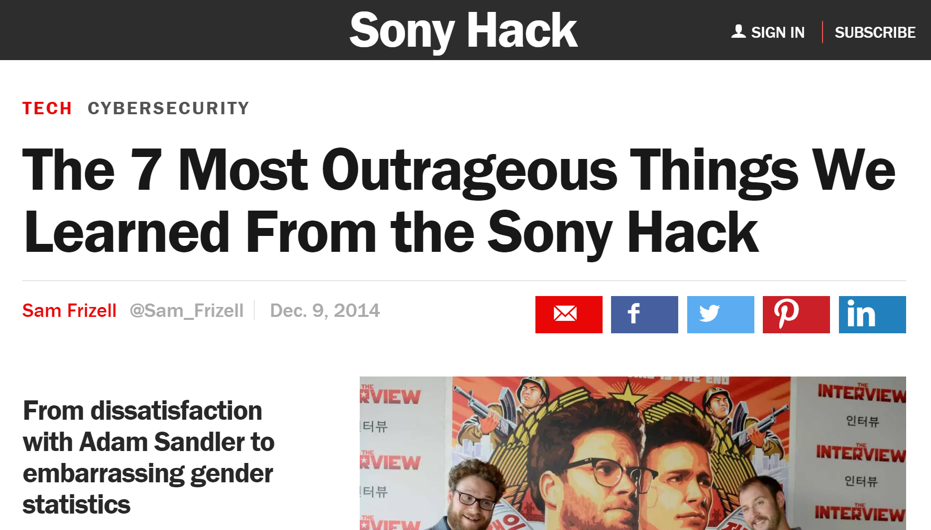
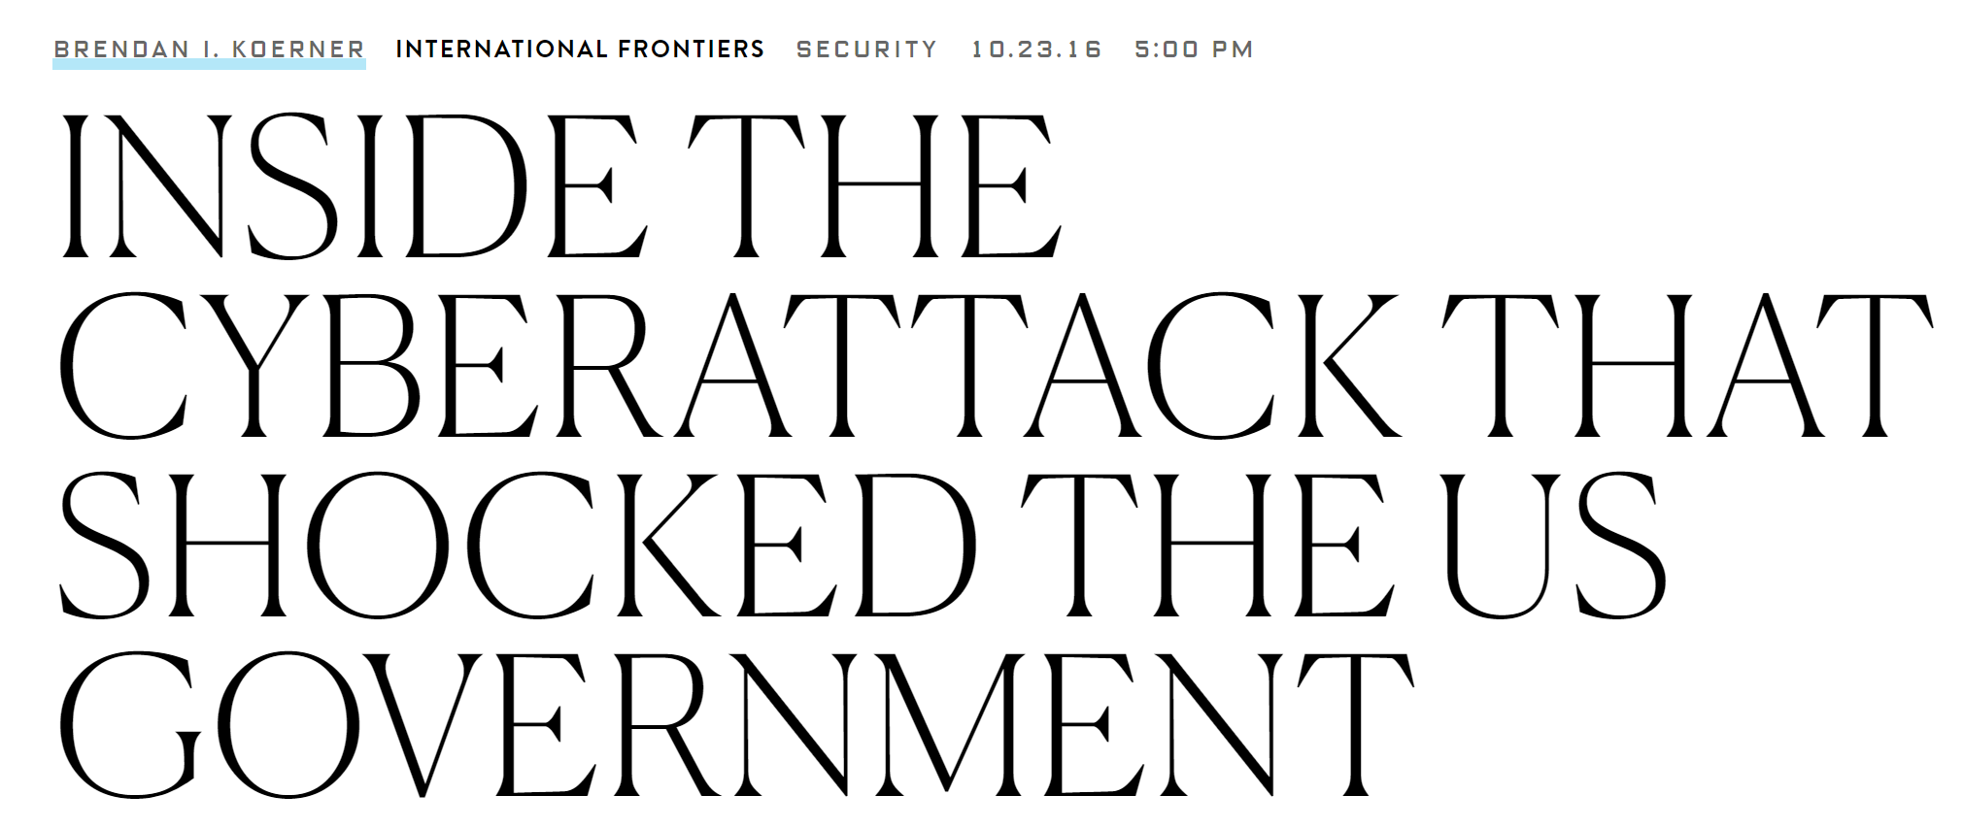
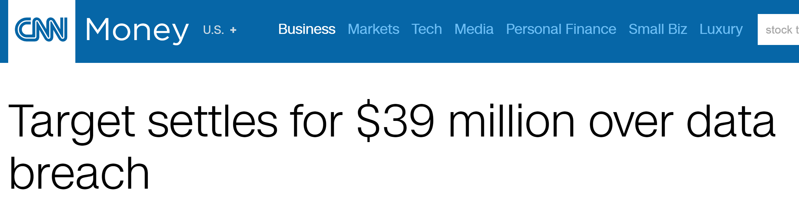

Slide 5
Today
My past research in phishing attacks
Is it possible to train people?
Can we create better browser warnings?
Mental models
What are common security misconceptions?
Still an active area of research, with lots of opportunities to help lots of people

Slide 6
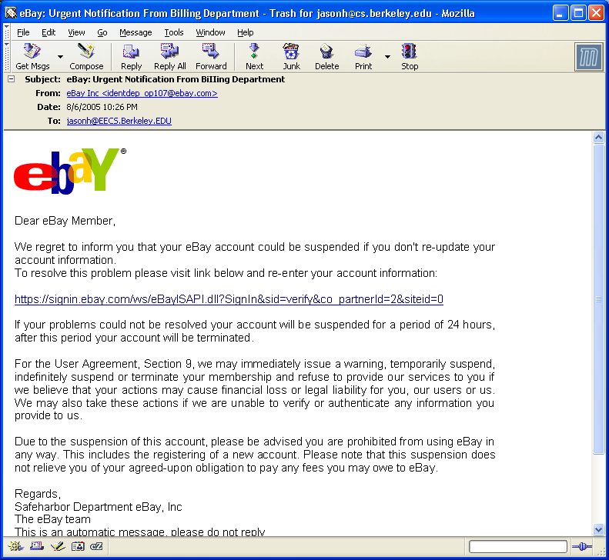
Everyday Privacy and Security Problem

Slide 7
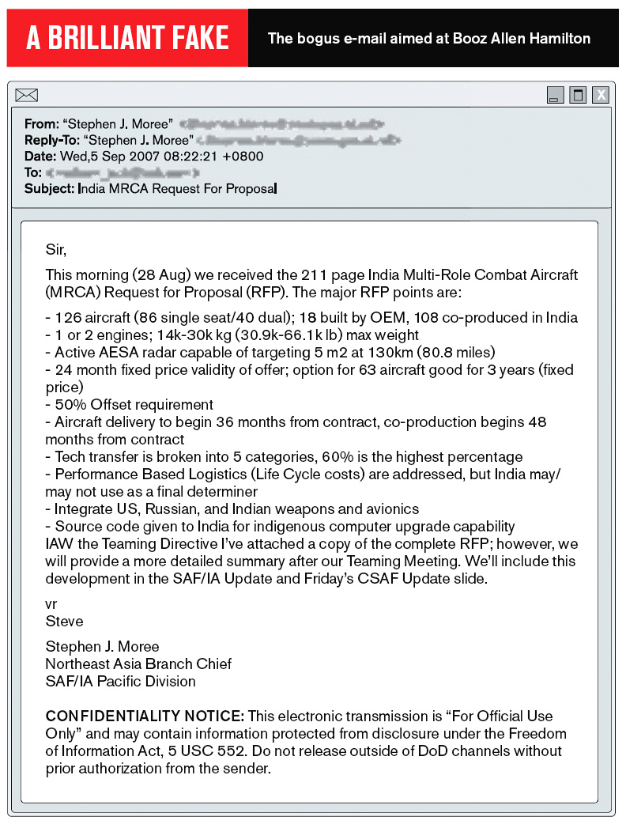
Notes:
Biz week http://www.businessweek.com/magazine/content/08_16/b4080032218430.htm
The e-mail message addressed to a Booz Allen Hamilton executive was mundane—a shopping list sent over by the Pentagon of weaponry India wanted to buy. But the missive turned out to be a brilliant fake. Lurking beneath the description of aircraft, engines, and radar equipment was an insidious piece of computer code known as "Poison Ivy" designed to suck sensitive data out of the $4 billion consulting firm's computer network.
The Pentagon hadn't sent the e-mail at all. Its origin is unknown, but the message traveled through Korea on its way to Booz Allen. Its authors knew enough about the "sender" and "recipient" to craft a message unlikely to arouse suspicion. Had the Booz Allen executive clicked on the attachment, his every keystroke would have been reported back to a mysterious master at the Internet address cybersyndrome.3322.org, which is registered through an obscure company headquartered on the banks of China's Yangtze River.

Slide 8
Phishing Increasing in Sophistication
Malware and phishing are combined now
Malware attachments (Ex. custom PDF exploits)
Links to web sites with malware (web browser exploits)
Can install keyloggers or remote access software

Slide 9
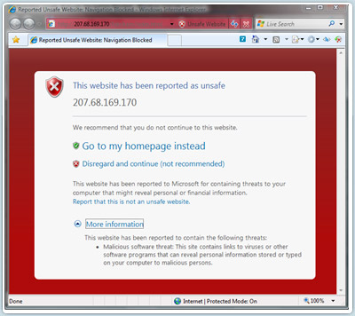
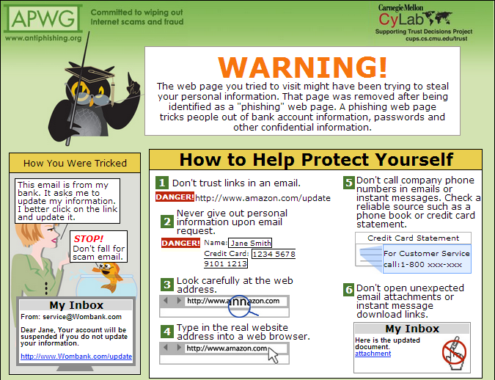

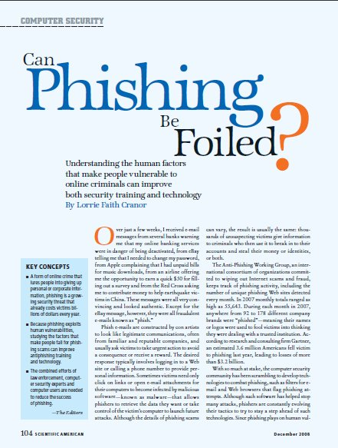
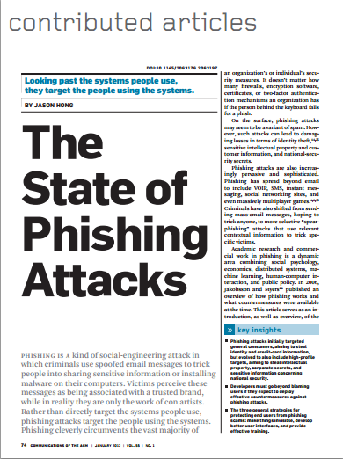
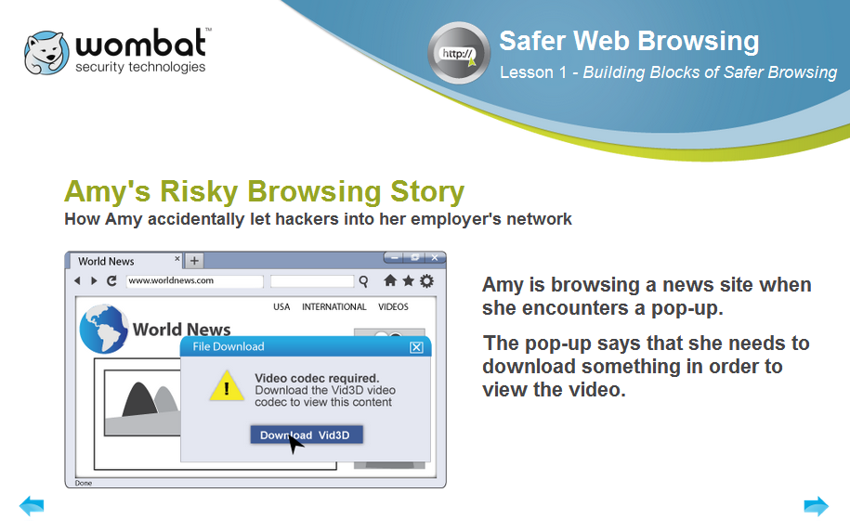
Influenced MSIE Warnings
APWG
Landing Page
Wombat Security
Technologies
SciAm & CACM

Slide 10
General Strategy for Usable Privacy and Security
Three pronged-approach, in order
Make it invisible (where possible)
Offer better user interfaces (affordances, mappings, mental models, etc)
Train users (where necessary)
Let’s discuss training first

Slide 11
User Education is Challenging
Users are not motivated to learn about security
Security is a secondary task
Difficult to teach people to make right online trust decision without increasing false positives
“User education is a complete waste of time. It is about as much use as nailing jelly to a wall…. They are not interested…they just want to do their job.”
Martin Overton, IBM security specialist http://news.cnet.com/21007350_361252132.html

Slide 12
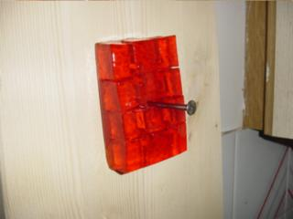
User Education is Challenging
Users are not motivated to learn about security
Security is a secondary task
Difficult to teach people to make right online trust decision without increasing false positives
“User education is a complete waste of time. It is about as much use as nailing jelly to a wall…. They are not interested…they just want to do their job.”
Martin Overton, IBM security specialist http://news.cnet.com/21007350_361252132.html

Slide 13

But Actually, Users Are Trainable
Our research demonstrates that users can learn to protect themselves from phishing… if you can get them to pay attention to training
P. Kumaraguru, S. Sheng, A. Acquisti, L. Cranor, and J. Hong. Teaching Johnny Not to Fall for Phish.

Slide 14
How Do We Get People Trained?
Solution
Create “teachable moments”: PhishGuru
Make training fun: Anti-Phishing Phil
Use learning science principles

Slide 15
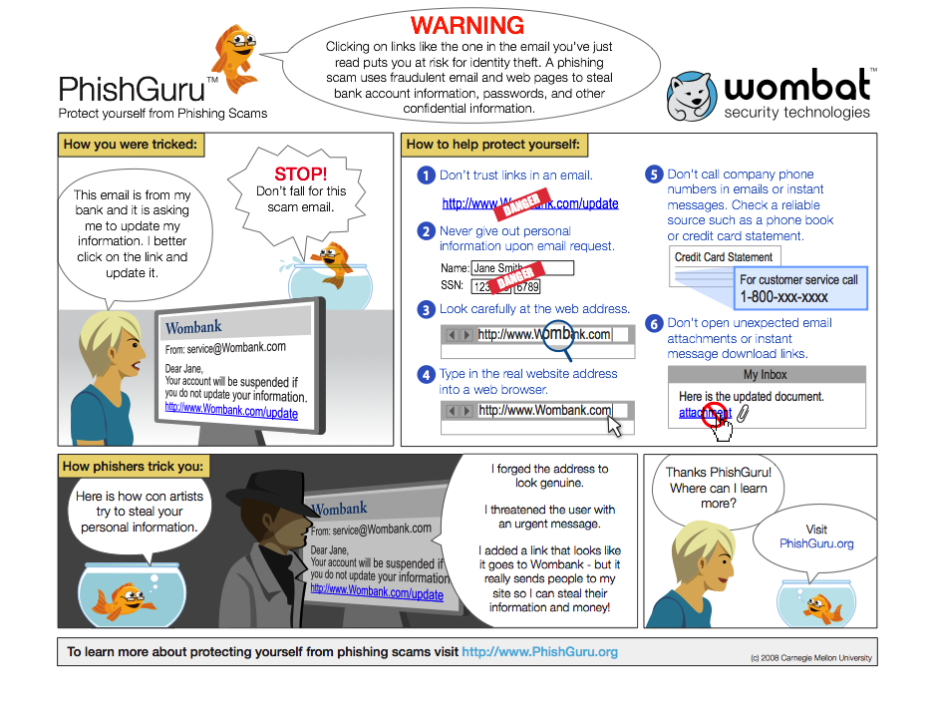
Learning Science
Area of research examining learning, retention, and transfer of skills
Example principles
Learning by doing
Immediate feedback
Conceptual-procedural
Reflection
Multimedia
… many others

Slide 16

PhishGuru Embedded Training
Send emails that look like a phishing attack
If recipient falls for it, show intervention teaching what cues to look for in engaging format
Will present one thread of research we did on PhishGuru
Notes:
16

Slide 17
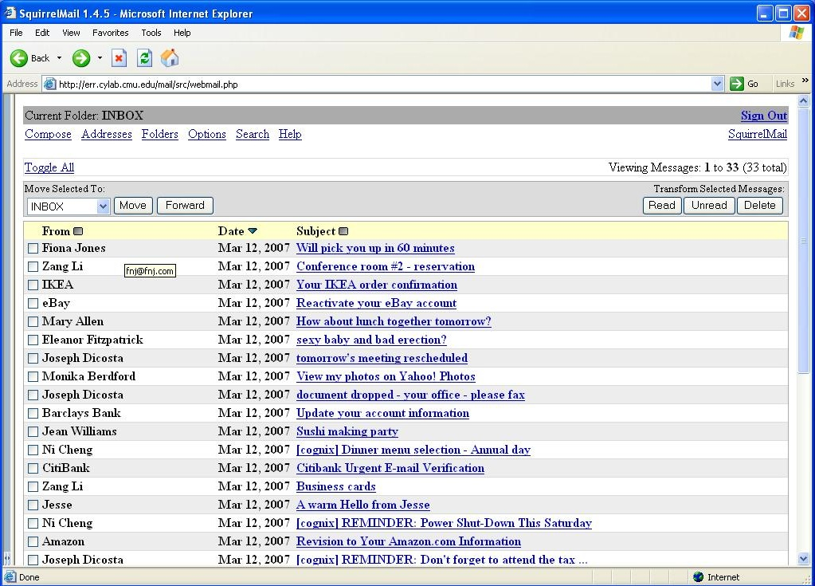
Subject: Revision to Your Amazon.com Information
Notes:
ASSUME THAT THIS IS YOUR EMAIL INBOX AND AMONG OTHER EMAILS.. YOU THIS EMAIL FROM AMAZON THAT JUST LOOKS LIKE THE LEGITIMATE EMAIL FROM AMAZON. WHEN YOU OPEN THE EMAIL ….

Slide 18
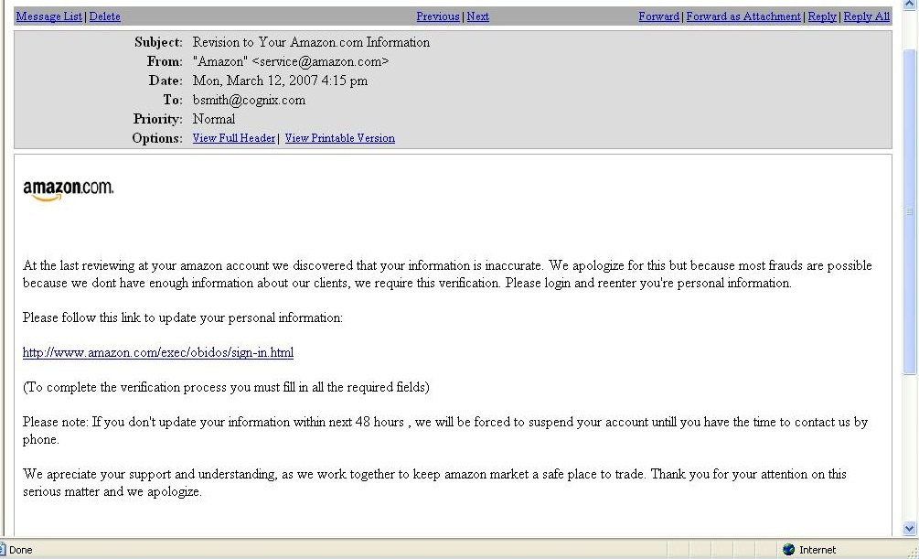
Subject: Revision to Your Amazon.com Information
Please login and enter your information
Notes:
YOU WILL SEE THIS.. WHICH LOOKS LEGITIMATE.. AND WITH THE DATA THAT WE HAVE .. WE KNOW THAT MOST OF THE USERS WILL CLICK ON THE LINK.. WHEN THEY CLICK ON THE LINK THEY WILL SEE ….

Slide 20
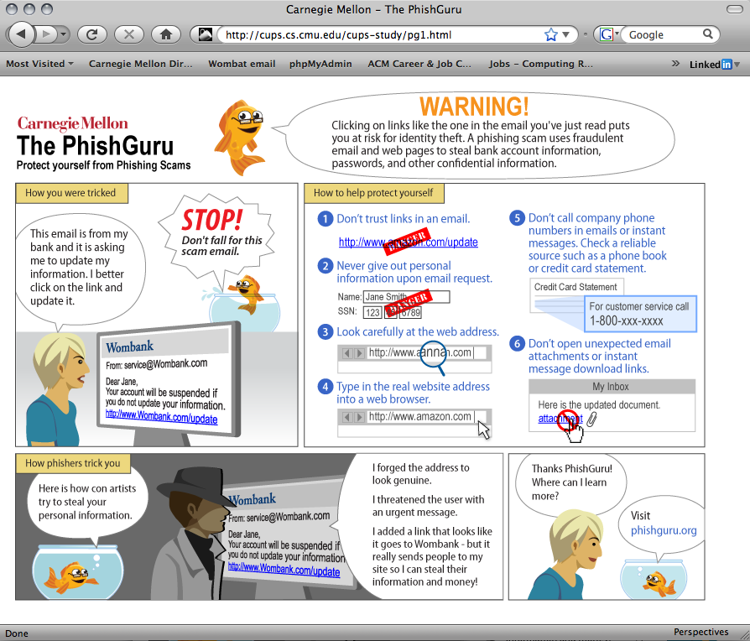
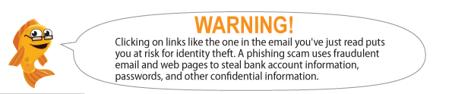
Tells people why they are seeing this message, uses engaging character
Notes:
THE USER WILL SEE THIS INTERVENTION… WHICH TELLS THEM HOW TO AVOID FALLING FROM PHISHING EMAILS… I WILL DESCRIBE IN DETAIL WHAT INFORMATION IS IN THIS INTERVENTION IN A COUPLE OF MINUTES.
You have the printout of this intervention…

Slide 21
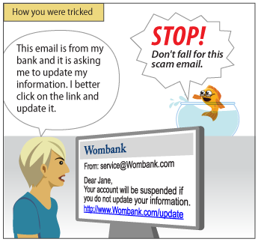
Tells a story about what happened and what the risks are
Notes:
THE USER WILL SEE THIS INTERVENTION… WHICH TELLS THEM HOW TO AVOID FALLING FROM PHISHING EMAILS… I WILL DESCRIBE IN DETAIL WHAT INFORMATION IS IN THIS INTERVENTION IN A COUPLE OF MINUTES.
You have the printout of this intervention…

Slide 22
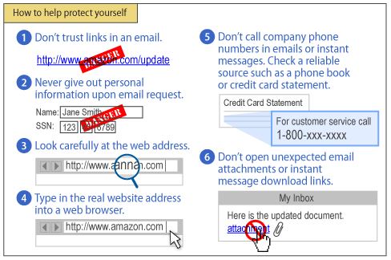
Gives concrete examples of how to protect oneself
Notes:
THE USER WILL SEE THIS INTERVENTION… WHICH TELLS THEM HOW TO AVOID FALLING FROM PHISHING EMAILS… I WILL DESCRIBE IN DETAIL WHAT INFORMATION IS IN THIS INTERVENTION IN A COUPLE OF MINUTES.
You have the printout of this intervention…

Slide 23
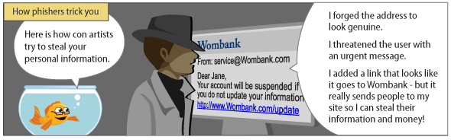
Explains how criminals conduct phishing attacks
Notes:
THE USER WILL SEE THIS INTERVENTION… WHICH TELLS THEM HOW TO AVOID FALLING FROM PHISHING EMAILS… I WILL DESCRIBE IN DETAIL WHAT INFORMATION IS IN THIS INTERVENTION IN A COUPLE OF MINUTES.
You have the printout of this intervention…

Slide 24
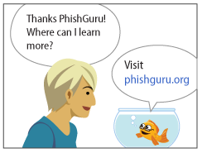
Notes:
THE USER WILL SEE THIS INTERVENTION… WHICH TELLS THEM HOW TO AVOID FALLING FROM PHISHING EMAILS… I WILL DESCRIBE IN DETAIL WHAT INFORMATION IS IN THIS INTERVENTION IN A COUPLE OF MINUTES.
You have the printout of this intervention…

Slide 25
Design Rationale
Why a cartoon?
Engaging format, more likely to read vs long web page
Why show training on click?
Vs fake login page and then show training
We found 90% people who click enter credentials
Send training straight to email inbox?
Delivering same training via direct email not effective!
Our previous study found people ignore
Why show criminal?
Wanted to foster clearer mental model
Notes:
25

Slide 26
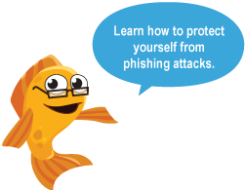
Evaluation of PhishGuru
Is embedded training effective?
Study 1: Lab study, 30 participants
Study 2: Lab study, 42 participants
Study 3: Field trial at company, ~300 participants
Study 4: Field trial at CMU, ~500 participants
Studies showed significant decrease in falling for phish and ability to retain what they learned
P. Kumaraguru et al. Protecting People from Phishing: The Design and Evaluation of an Embedded Training Email System. CHI 2007.
P. Kumaraguru et al. Getting Users to Pay Attention to Anti-Phishing Education: Evaluation of Retention and Transfer. eCrime 2007.
Notes:
P. Kumaraguru et al. Protecting People from Phishing: The Design and Evaluation of an Embedded Training Email System. CHI 2007.
P. Kumaraguru et al. Getting Users to Pay Attention to Anti-Phishing Education: Evaluation of Retention and Transfer. eCrime 2007.

Slide 27

Study #4 at CMU
Investigated effectiveness and retention of training after 1 week, 2 weeks, and 4 weeks
Compared effectiveness of 2 training messages vs 1 training message
Examined demographics and phishing
P. Kumaraguru, J. Cranshaw, A. Acquisti, L. Cranor, J. Hong, M. A. Blair, and T. Pham. School of Phish: A Real-World Evaluation of Anti-Phishing Training. 2009. SOUPS 2009.
Notes:
TO ADDRESS SOME OF THE LIMITATIONS IN THIS STUDY, I AM CURRENTLY DOING THIS EXCITING STUDY AMONG CMU STUDENTS/FACULTY/STAFF WHERE I AM PHISHING THEM FOR THE LAST 4 WEEKS…
I WAS INTERESTED IN STUDYING LONG TERM RETENTION .. MORE THAN 1 WEEK.. SO IN THIS STUDY WE ARE STUDYING 4 WEEK RETENTION..
IN PREVIOUS STUDY WE STUDIED 1 TRAINING MATERIAL… HERE WE ARE STUDYING 2 MESSAGES…
THIS STUDY IS REALLY IN THE WILD AND WE ARE COLLECTING LOT OF DATA…. I M STILL IN THE DATA COLLECTION MODE IN A FEW WEEKS, I SHOULD HAVE SOME RESULTS FROM THIS STUDY…
27

Slide 28

Study Design
Sent email to all CMU students, faculty and staff to recruit participants (opt-in)
515 participants in three conditions
Control / One training msg (day 0) / Two msgs (day 14)
Emails sent over 28 day period
7 simulated spear-phishing messages
3 legitimate (cyber security scavenger hunt)
Campus help desks and IT departments notified before messages sent
Notes:
Spear phishing emails are targetted phishing emails
COLLECTING VARIETY OF INFORMATION (HR, COMPLAINTS THAT ARE BEING LOGGED TO HELP CENTERS AND ISO)
COUNTERBALANCING THE EMAILS
COLLECTING DATA FOR LEGITIMATE EMAILS TO SEE WHETHER TRAIING INCREASES CONCERN
28

Slide 29
Your Hypotheses
About how many people will fall for initial spear-phish?
Which CMU demographic most likely to fall for phish?
Younger, middle, oldest?
Will two training messages be effective over one?
Notes:
29

Slide 30
Effect of PhishGuru Training
Condition | N | % who clicked on Day 0 | % who clicked on Day 28
Control | 172 | 52.3 | 44.2
Trained | 343 | 48.4 | 24.5
Notes:
The idea in this slide is to show that training conditions did better than control conditions and it was significantdifferenc… There is an improvement of 50% among people in PhihsGuru training
30

Slide 31

Discussion of PhishGuru
PhishGuru can teach people to identify phish better
People retain the knowledge
People trained on first day less likely to be phished
Two training messages work better
People aren’t resentful, many happy to have learned
68 out of 85 surveyed said they recommend CMU continue doing this sort of training in future
“I really liked the idea of sending CMU students fake phishing emails and then saying to them, essentially, HEY! You could've just gotten scammed! You should be more careful -- here's how....”
Notes:
People weren’t less likely to click on legitimate emails

Slide 32
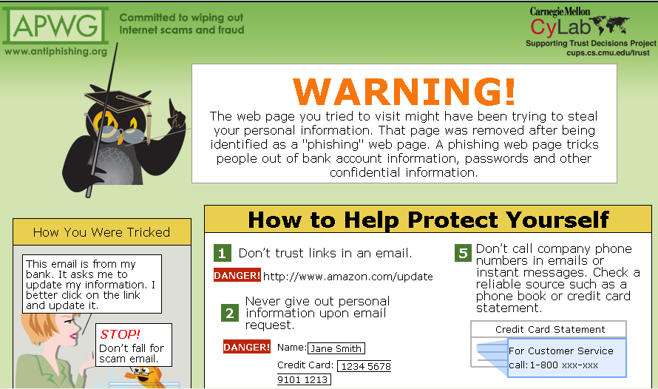
APWG Landing Page
CMU and Wombat helped Anti-Phishing Working Group develop landing page for taken down sites
Already in use by several takedown companies
Seen by ~200,000 people (2009-2011), much more now

Slide 33

Anti-Phishing Phil
A mini-game to teach people not to fall for phish
PhishGuru about email, this game about web browser
Also based on learning science principles
Goals
How to parse URLs
Where to look for URLs
Use search engines if you’re not sure
S. Sheng et al. Anti-Phishing Phil: The Design and Evaluation of a Game That Teaches People Not to Fall for Phish. In SOUPS 2007, Pittsburgh, PA, 2007.
Notes:
S. Sheng, B. Magnien, P. Kumaraguru, A. Acquisti, L. Cranor, J. Hong, and E. Nunge. Anti-Phishing Phil: The Design and Evaluation of a Game That Teaches People Not to Fall for Phish. In Proceedings of the 2007 Symposium On Usable Privacy and Security, Pittsburgh, PA, July 18-20, 2007.

Slide 34
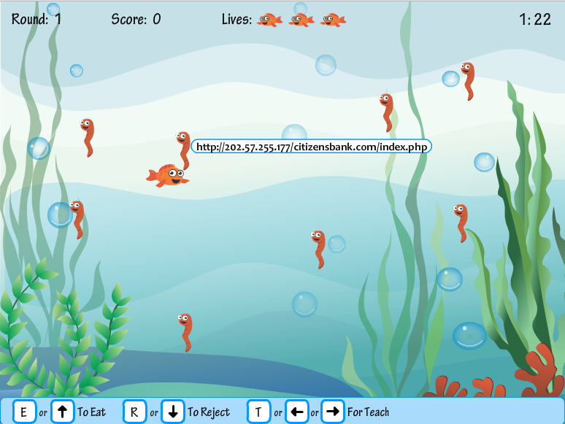

Slide 35
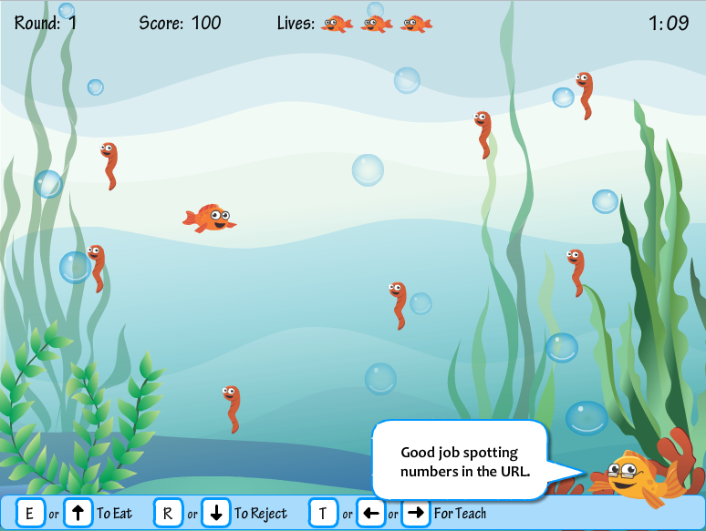

Slide 36
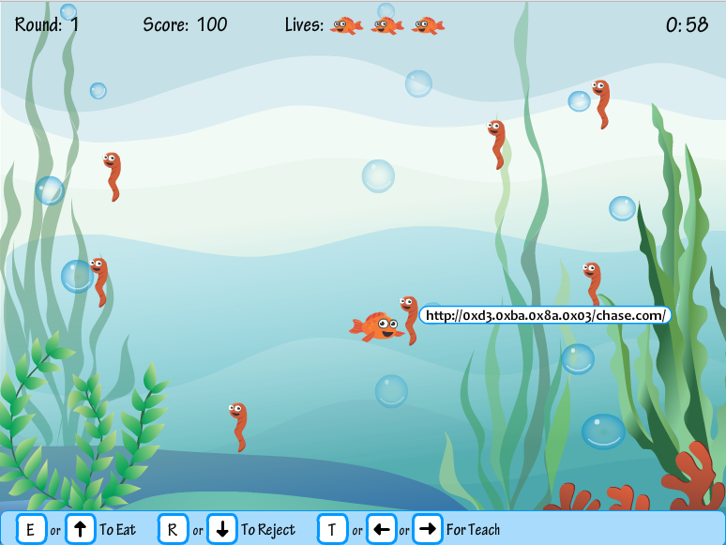

Slide 37


Slide 38
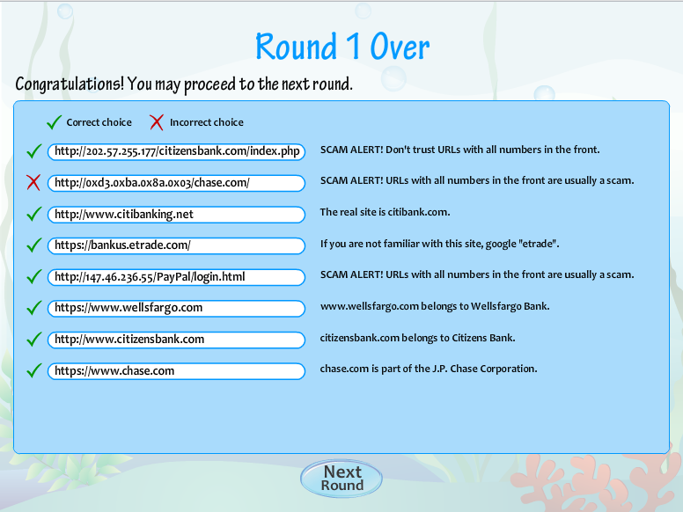

Slide 39
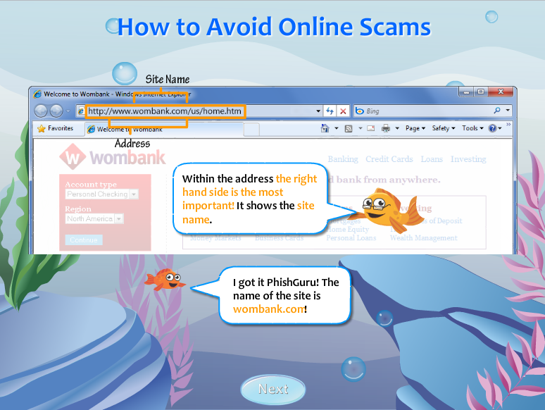

Slide 40
Design Rationale
Multiple levels
8 URLs per level, get progressively harder
Intermediate screens to teach principles
Teach and then test
Immediate feedback principle
Conceptual-procedural principle
Timer to add a little bit of pressure

Slide 41
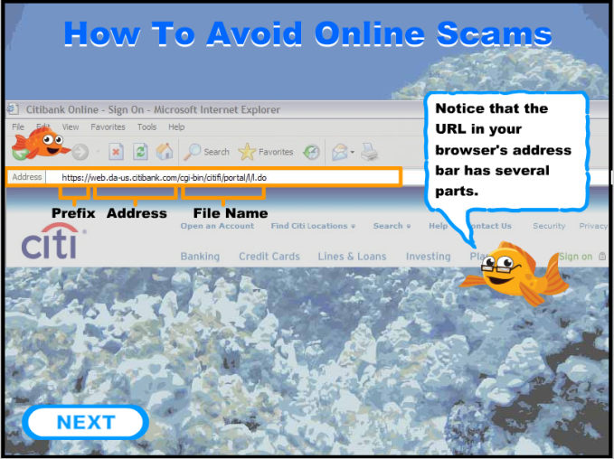
Evaluation of Anti-Phishing Phil
Is Phil effective?
Study 1: 56 people in lab study
Study 2: 4517 people in field trial
Brief results of Study 1
Phil about as effective in helping people detect phishing web sites as paying people to read training material
But Phil has significantly fewer false positives overall
Suggests that existing training material making people paranoid about phish rather than differentiating

Slide 42
Evaluation of Anti-Phishing Phil
Study 2: 4517 participants in field trial
Randomly selected from 80000 people
Conditions
Control: Label 12 sites as phish/not then play game
Game: Label 6 sites, play game, then label 6 more, then after 7 days, label 6 more (18 total)
Participants
2021 people in game condition, 674 did retention portion

Slide 43
Anti-Phishing Phil: Study 2
Novices showed most improvement in false negatives (calling phish legitimate)

Slide 44
Anti-Phishing Phil: Study 2
Improvement all around for false positives

Slide 45
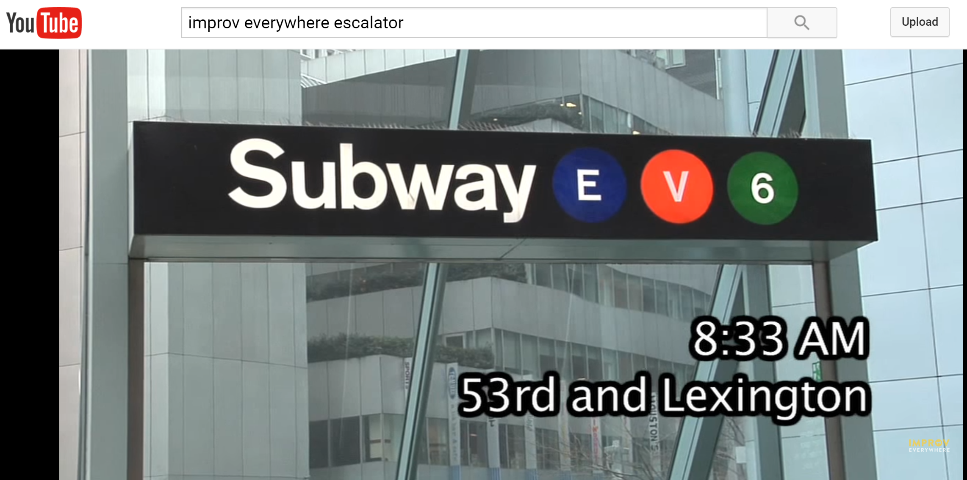
Short Video Break
https://www.youtube.com/watch?v=Abt8aAB-Dr0
Notes:
Don’t underestimate your potential to improve people’s lives, even in a small way

Slide 46
Stepping Back
Three pronged-approach, in order
Make it invisible
Offer better user interfaces
Train users
For better user interfaces, how?

Slide 47
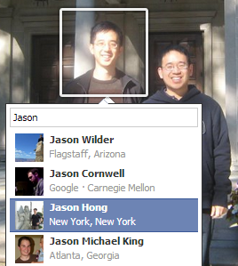
Why are GUIs for Security Hard?
Lots of security terminology
You have digital keys to “encrypt” things
You can also use digital keys to sign things
Lots of complexity
Ex. Might have multiple sharing policies
Ex. Some tasks might need to be harder to prevent attacks (account creation)
Security is a secondary task
You don’t go to Dropbox to do security

Slide 48
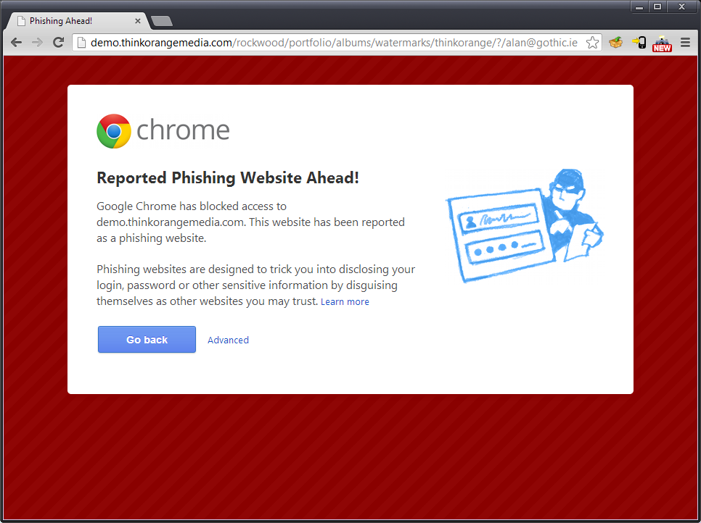
Every browser now has basic anti-phishing detection built in
Are these user interfaces effective?
Our 2008 study on warnings
And what does it mean for training?
Notes:
Modern web browsers have special warnings for identifying phish
Our evaluation of several blacklists show they catch ~80% of phish after 24 hours, but not very good in first few hours
Are these browser interfaces effective?
What makes them work (or not)?
After, step back and consider what this all means for training

Slide 49
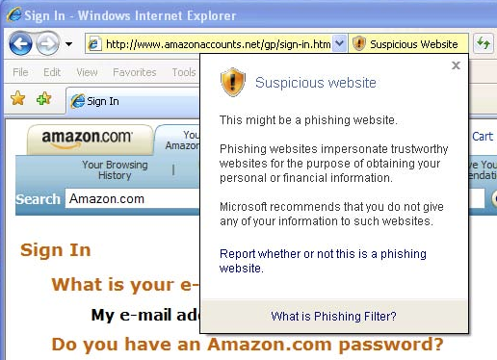
Screenshots
Internet Explorer – Passive Warning

Slide 50
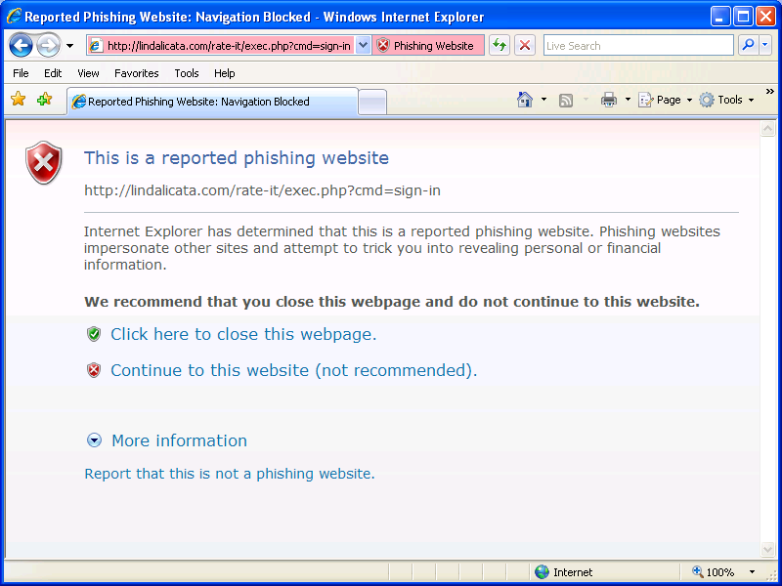
Screenshots
Internet Explorer – Active Block

Slide 51
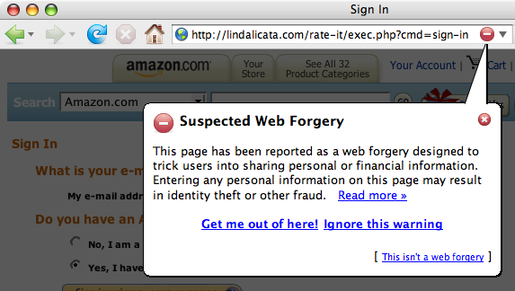
Screenshots
Mozilla FireFox – Active Block

Slide 52

How Effective are these Warnings?
Tested four conditions
FireFox Active Block
IE Active Block
IE Passive Warning
Control (no warnings or blocks)
“Shopping Study”
Setup some fake phishing pages and added to blacklists
We phished users after purchases (2 phish/user)
Real email accounts and personal information
S. Egelman, L. Cranor, and J. Hong. You've Been Warned: An Empirical Study of the Effectiveness of Web Browser Phishing Warnings. CHI 2008.
Notes:
S. Egelman, L. Cranor, and J. Hong. You've Been Warned: An Empirical Study of the Effectiveness of Web Browser Phishing Warnings. CHI 2008.

Slide 53
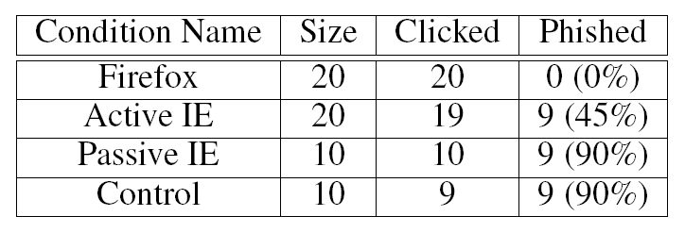
How Effective are these Warnings?
Almost everyone clicked, even those with technical backgrounds

Slide 54
How Effective are these Warnings?

Slide 55
Discussion of Phish Warnings
Nearly everyone will fall for highly contextual phish
Passive IE warning failed for many reasons
Didn’t interrupt the main task
Slow to appear (up to 5 seconds)
Not clear what the right action was
Looked too much like other ignorable warnings (habituation)
Bug in implementation, any keystroke dismisses

Slide 56
Screenshots
Internet Explorer – Passive Warning

Slide 57
Discussion of Phish Warnings
Active IE warnings
Most saw but did not believe it
“Since it gave me the option of still proceeding to the website, I figured it couldn’t be that bad”
Some element of habituation (looks like other warnings)
Saw two pathological cases

Slide 58
Screenshots
Internet Explorer – Active Block

Slide 59
A Science of Warnings (C-HIP)
See the warning?
Understand?
Believe it?
Motivated?
Can and will act?

Slide 60
Internet Explorer 8 Re-design

Slide 61
Mental Models
Lots of mismatches between experts and novices in computer security
Exercise (2 min, find partner)
What top two pieces of security advice you would give friend who knows little about computing?

Slide 62
Your Security Advice

Slide 63
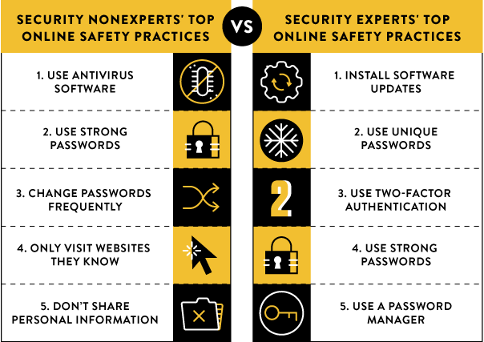
Notes:
https://security.googleblog.com/2015/07/new-research-comparing-how-security.html

Slide 64
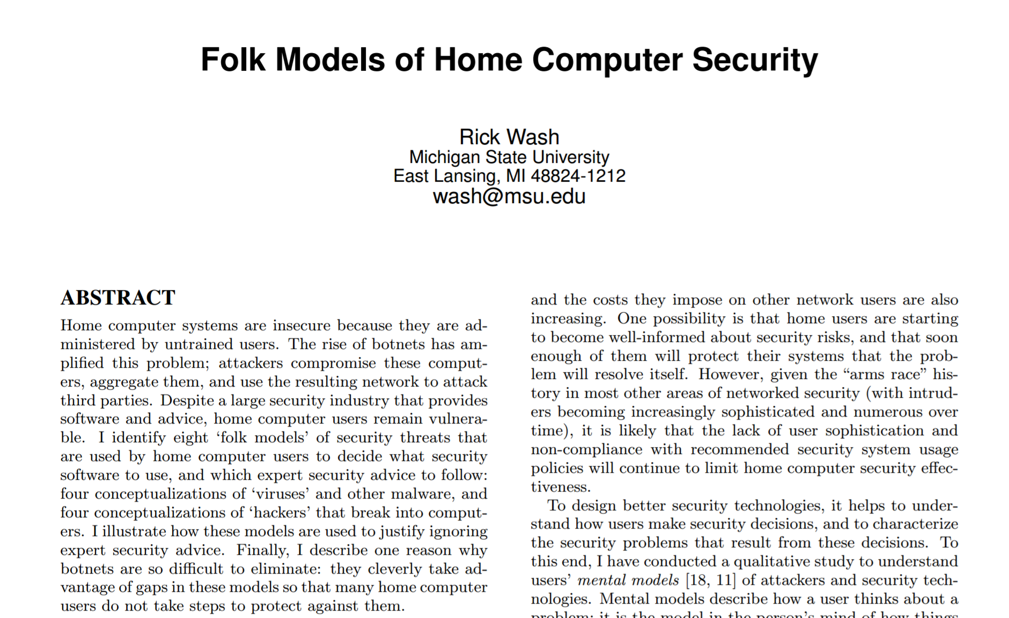
Fostering Good Mental Models for Security is Hard

Slide 65
Folk Models
“Folk models are mental models that are not necessarily accurate in the real world, thus leading to erroneous decision making, but are shared among similar members of a culture”

Slide 66
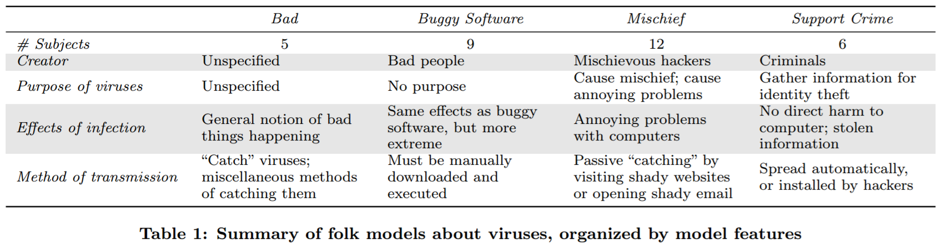
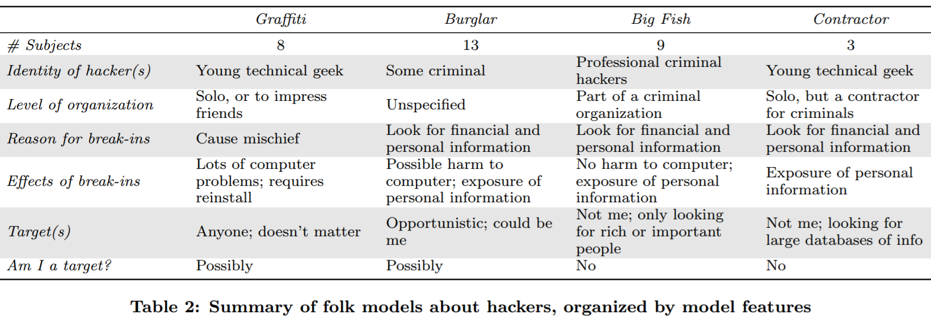
Folk Models

Slide 67
Discussion of Folk Models
People will always build their own mental models of your system and of an area
In this case, security
If people have “incorrect” mental model, might not take good steps to protect themselves
Still an open question as to best ways of fostering better mental models for security
Not a lot of great answers so far
But this is also a design opportunity

Slide 68
Key Ideas from Today or, Potentially Good Exam Questions
Three general design strategies for usable privacy and security
Make it invisible, offer better user interfaces, train
Learning science principles
C-HIP model of security warnings
See warning, understand, believe, motivated, act
Many security problems stem from mental models
Though really hard since it’s an area vs a single product
People build folk models regardless

